Slide 1

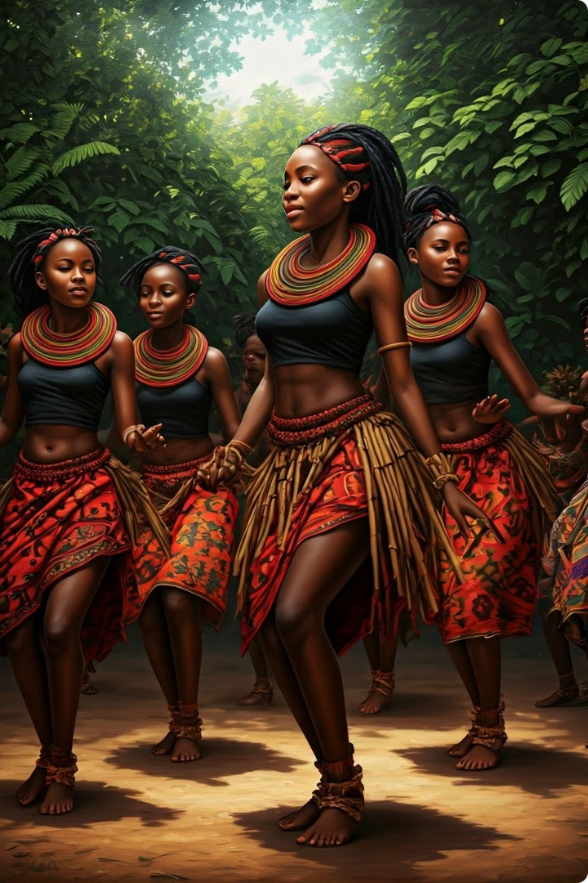
The Importance of the Zulu Reed Dance and Gender Awareness in African Society
The Zulu Reed Dance, or Umkhosi Womhlanga, is one of South Africa's most celebrated cultural events, showcasing the rich traditions and social structures of the Zulu people. Held annually, this festival marks a significant rite of passage for young Zulu girls, symbolizing their transition from adolescence to womanhood. The Reed Dance is a profound expression of cultural heritage, social cohesion, and communal values. However, this tradition also presents an opportunity to explore gender dynamics and highlight the importance of gender awareness within African societies. This essay delves into the significance of the Reed Dance and discusses the need for gender awareness to foster inclusivity and equality within the cultural framework.

Slide 2
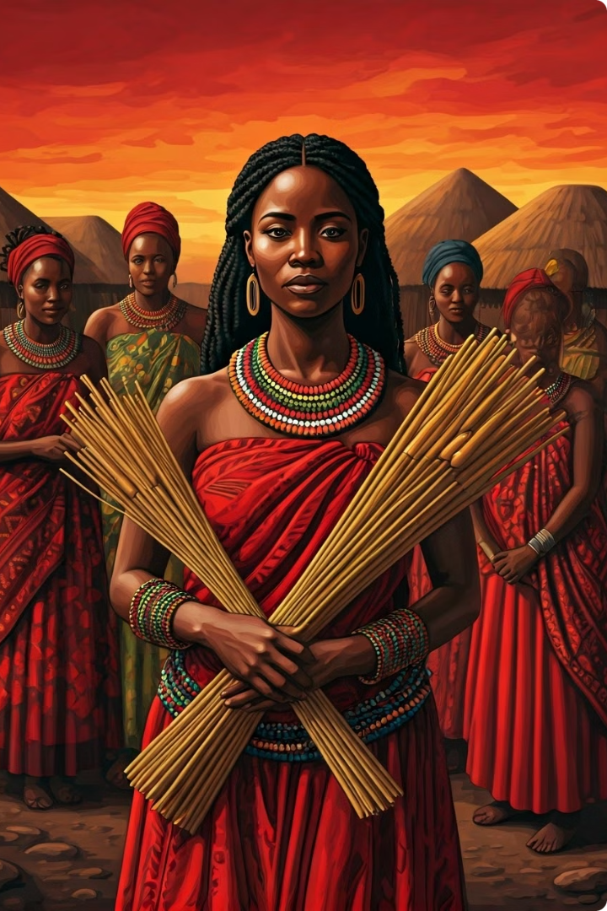
Cultural Significance of the Zulu Reed Dance
1
Preservation of Tradition
The Reed Dance is a key mechanism for preserving and transmitting Zulu cultural values and practices. Through this festival, traditional stories, customs, and social norms are passed down from generation to generation. It reinforces the importance of communal values, respect for elders, and adherence to cultural rituals.
2
Social Cohesion
The Reed Dance serves as a unifying event for the Zulu community. It brings together individuals from various regions to participate in a shared cultural experience, strengthening community bonds and fostering a sense of collective identity. The festival also plays a role in reinforcing social hierarchies and communal responsibilities.
3
Rite of Passage
For the young women participating in the Reed Dance, the festival represents a significant rite of passage. It marks their transition from childhood to adulthood and signifies their readiness to take on new roles and responsibilities within the community. The ceremony highlights the value placed on maturity, respect, and social contributions.

Slide 3
Gender Awareness in the Context of the Reed Dance
Traditional Gender Roles
Opportunities for Empowerment
The Reed Dance reflects traditional Zulu gender roles, where women are celebrated for their purity and readiness to assume domestic and communal responsibilities. While the festival honors young women, it also reinforces specific expectations related to femininity and social conduct. Gender awareness involves critically examining these roles and considering how they impact women's opportunities and freedoms.
The Reed Dance can be an opportunity to address gender disparities by promoting the empowerment of young women. While the festival celebrates their transition to adulthood, integrating gender awareness can ensure that women are also encouraged to pursue education, leadership roles, and career opportunities. Recognizing the contributions of women beyond traditional roles supports a more inclusive and equitable society.

Slide 4
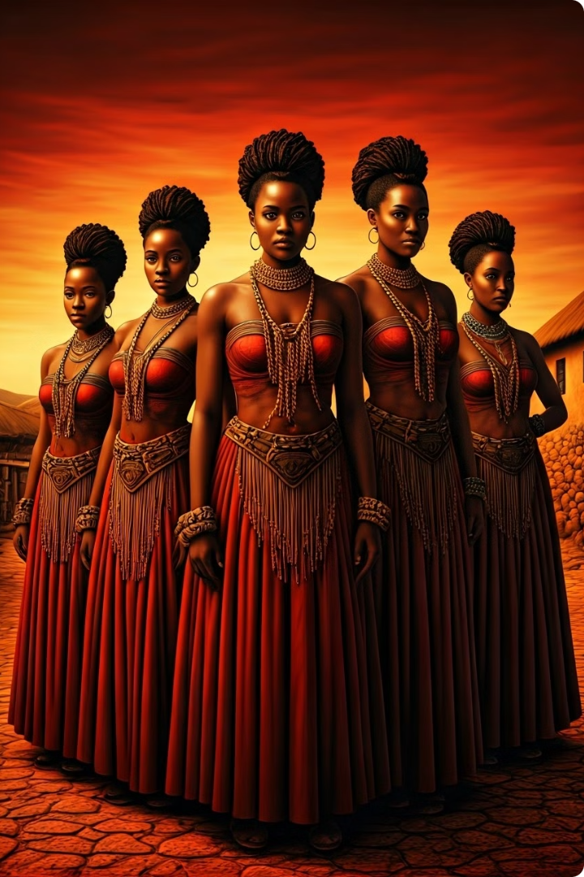



Challenging Stereotypes
Step 1
Gender awareness involves challenging stereotypes and biases that may be perpetuated by traditional practices.
Step 2
By fostering an environment where women's voices and contributions are valued equally, the Reed Dance can evolve to reflect more progressive and inclusive attitudes.
Step 3
This includes rethinking cultural practices to ensure they align with contemporary values of equality and respect.

Slide 5
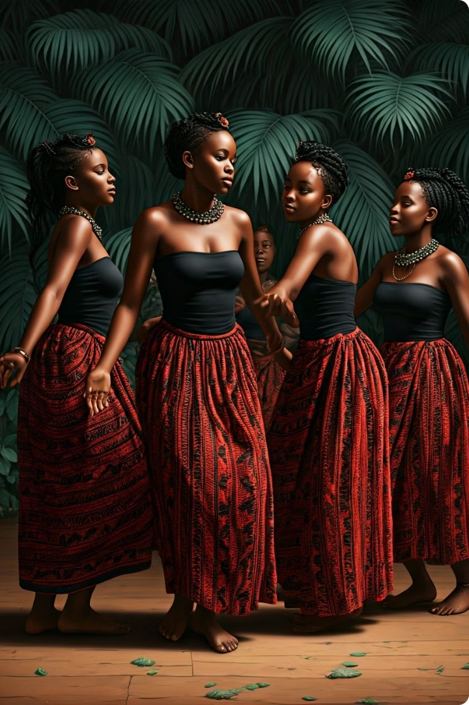
Conclusion
Cultural Significance
The Zulu Reed Dance is a vital cultural tradition that embodies the rich heritage and communal values of the Zulu people.
Rite of Passage
It serves as a powerful rite of passage, celebrating the transition of young women into adulthood and reinforcing cultural identity.
Gender Awareness
However, the festival also provides an opportunity to address traditional gender roles and promote gender awareness.

Slide 6
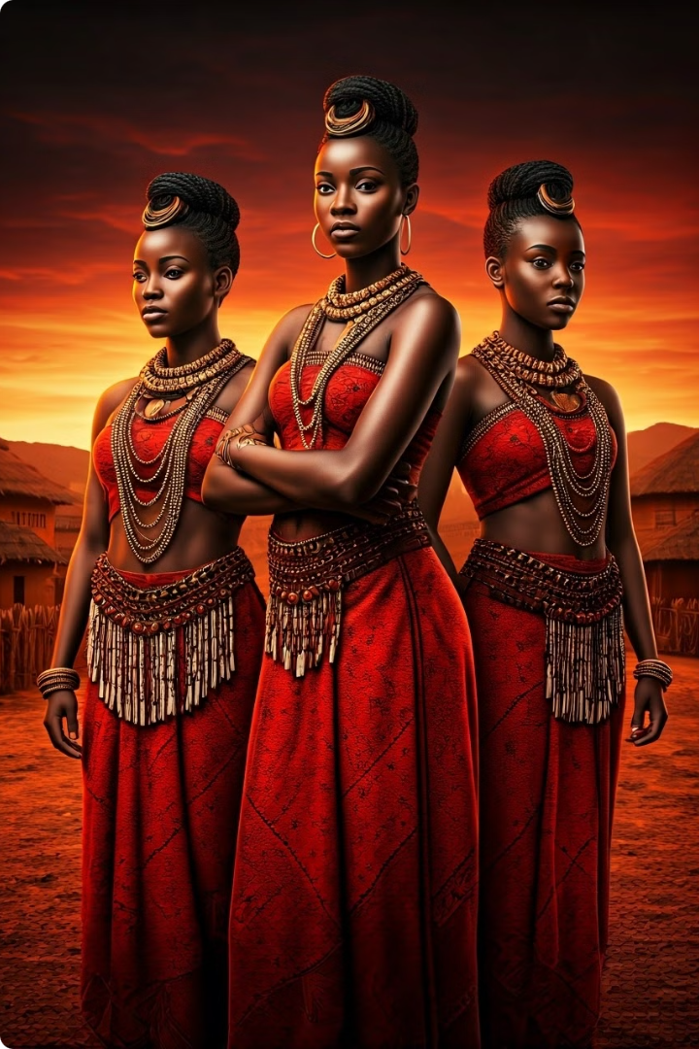
Promoting Inclusivity and Equality
1
Step 1
By integrating gender awareness into the practice of the Reed Dance, the Zulu community can foster greater inclusivity.
2
Step 2
Empower young women, and support broader social progress.
3
Step 3
This approach not only enhances the cultural significance of the Reed Dance but also contributes to a more equitable and harmonious society.

Slide 7
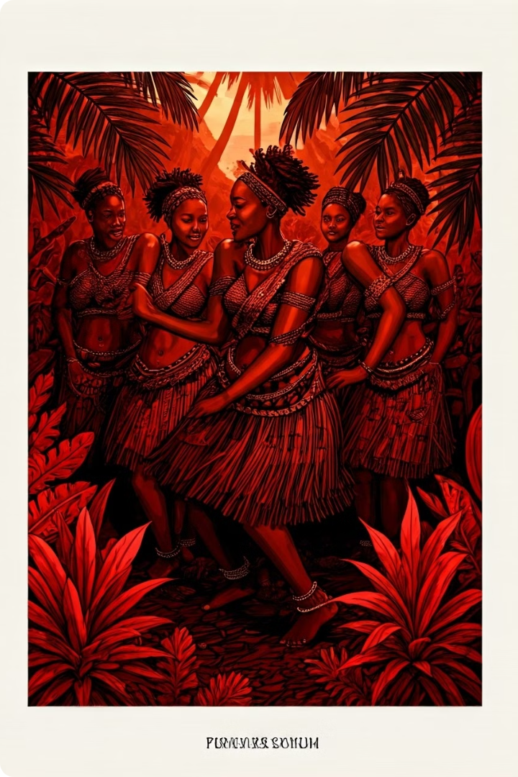
The Future of the Zulu Reed Dance
Tradition
Modernity
Preservation of cultural values
Promotion of gender equality
Reinforcement of social hierarchies
Empowerment of young women
Celebration of femininity
Recognition of diverse roles and contributions

Slide 8
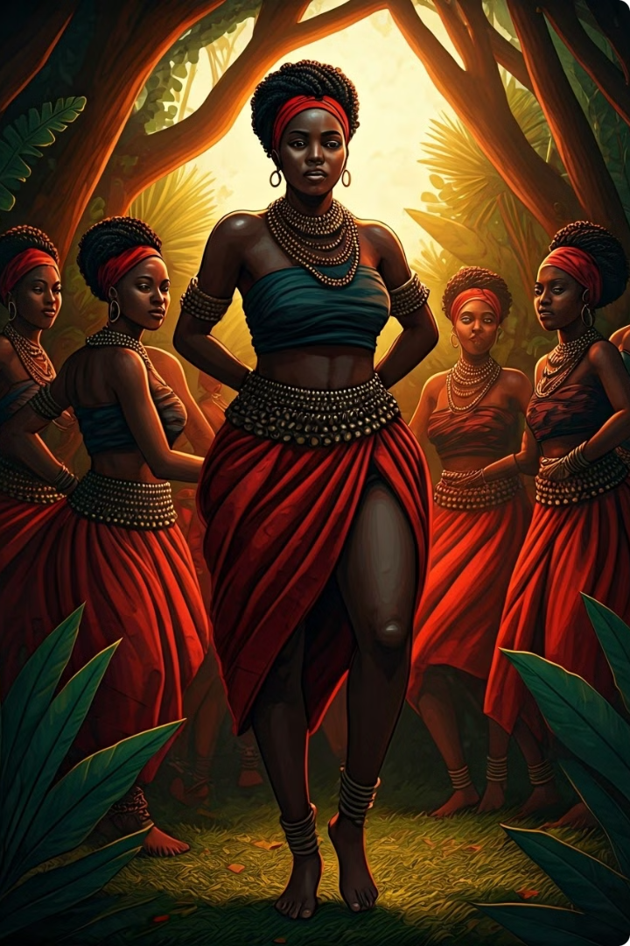



Preserving Heritage and Advancing Social Justice
Balance
Recognizing the importance of both cultural traditions and gender awareness is essential for preserving heritage while advancing social justice and equality.
Progress
The Zulu Reed Dance, when approached with a conscious effort to promote gender awareness, can become a powerful symbol of progress and inclusivity within the Zulu community and beyond.
Equality
By embracing both tradition and contemporary values of equality, the Reed Dance can continue to be a vibrant celebration of Zulu culture while contributing to a more just and equitable society.

Slide 9
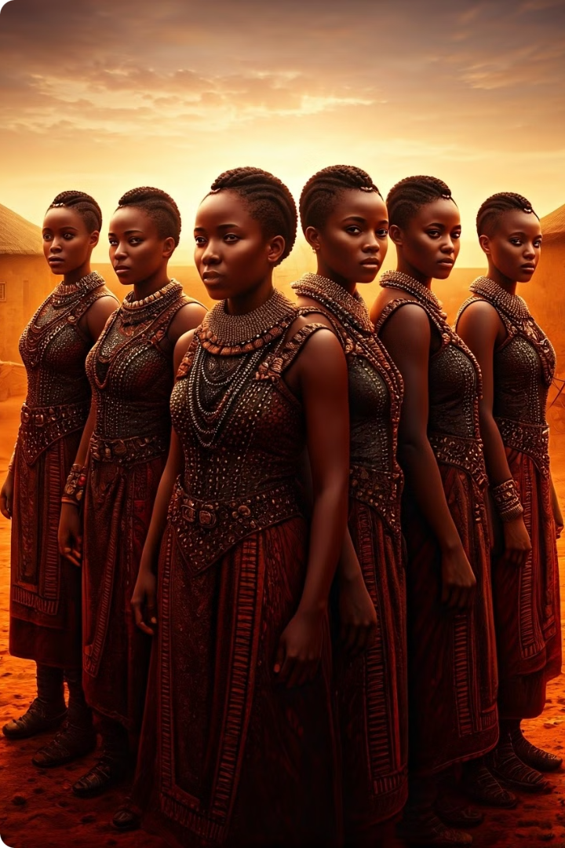
A Call for Action
The Zulu Reed Dance stands as a testament to the enduring power of cultural traditions. By embracing gender awareness, the Zulu community can ensure that this cherished festival continues to evolve, reflecting the values of inclusivity, equality, and progress. This approach will not only preserve the rich heritage of the Zulu people but also contribute to a more just and equitable society for all.

